Slide 1
Project Quality Management
Information Technology Project Management

Slide 2
The Importance of Project Quality Management
Many people joke about the poor quality of IT products
People seem to accept systems being down occasionally or needing to reboot their PCs
But quality is very important in many IT projects

Slide 3
What Went Wrong?
In 1986, two hospital patients died after receiving fatal doses of radiation from a Therac 25 machine after a software problem caused the machine to ignore calibration data
Britain’s Coast Guard was unable to use its computers for several hours in May 2004 after being hit by the Sasser virus, which knocked out the electronic mapping systems, e-mail, and other computer functions, forcing workers to revert to pen, paper, and radios
More than 100 incidents of lost or stolen financial information were reported over the past year, 200,000 online trading customers

Slide 4
What Is Project Quality?
The International Organization for Standardization (ISO) defines quality as “the degree to which a set of inherent characteristics fulfills requirements” (ISO9000:2000)
Other experts define quality based on:
Conformance to requirements: the project’s processes and products meet written specifications
Fitness for use: a product can be used as it was intended

Slide 5
What Is Project Quality Management?
Project quality management ensures that the project will satisfy the needs for which it was undertaken
Processes include:
Quality planning: identifying which quality standards are relevant to the project and how to satisfy them
Quality assurance: periodically evaluating overall project performance to ensure the project will satisfy the relevant quality standards
Quality control: monitoring specific project results to ensure that they comply with the relevant quality standards

Slide 6
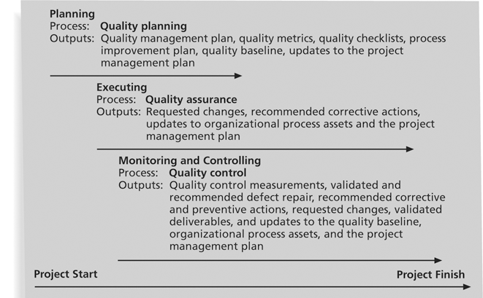
Project Quality Management Summary

Slide 7
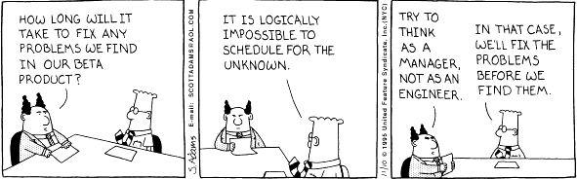
Quality Planning
Implies the ability to anticipate situations and prepare actions to bring about the desired outcome
Important to prevent defects by:
Selecting proper materials
Training and indoctrinating people in quality
Planning a process that ensures the appropriate outcome

Slide 8
Design of Experiments
Design of experiments is a quality planning technique that helps identify which variables have the most influence on the overall outcome of a process
Computer chip designer would determine what combination of materials and equipment will produce the most reliable chips at a reasonable cost
Also applies to project management issues, such as cost and schedule trade-offs
Junior programmers cost less than senior programmers but will not produce the same level of work in the same amount of time
An appropriately designed experiment to compute` project costs and durations for various combinations of staff can help determine an optimal mix of personnel
Involves documenting important factors that directly contribute to meeting customer requirements

Slide 9
Scope Aspects of IT Projects
It is often difficult for customers to explain exactly what they want in an IT project. Important scope aspects of IT projects that affect quality include:
Functionality is the degree to which a system performs its intended function
Features are the system’s special characteristics that appeal to users. It is important to specify which are required and which are optional
System outputs are the screens and reports the system generates. Need to define clearly what they look like
Performance addresses how well a product or service performs the customer’s intended use.
Need to know volumes of data and transactions, number of simultaneous users, required response time, etc.
Reliability is the ability of a product or service to perform as expected under normal conditions (customers must define expected level of service)
Maintainability addresses the ease of performing maintenance on a product

Slide 10
Who’s Responsible for the Quality of Projects?
Project managers are ultimately responsible for quality management on their projects
Several organizations and references can help project managers and their teams understand quality
International Organization for Standardization (www.iso.org)
When products, systems, machinery and devices work well and safely, it is often because they meet standards. The organization responsible for many thousands of the standards which benefit the world is ISO (derived from the Greek isos, meaning “equal”)
IEEE – Standards Association (www.ieee.org)
A leading, developer of industry standards in a broad-range of industries (Power and Energy, Information Technology, Telecommunications, Transportation, Medical and Healthcare, nanotechnology, cybersecurity, information assurance, and green technology) . Globally recognized

Slide 11
Quality Assurance
Quality assurance includes all the activities related to satisfying the relevant quality standards for a project
Another goal of quality assurance is continuous quality improvement
Benchmarking generates ideas for quality improvements by comparing specific project practices or product characteristics to those of other projects or products within or outside the performing organization
A quality audit is a structured review of specific quality management activities that help identify lessons learned that could improve performance on current or future projects
Perfomed by in-house auditors or third parties

Slide 12
Quality Control
Although one of the main goals of QC is to improve quality, its main outcomes are:
Acceptance decisions- are the products/services acceptable or should they be rejected and rework is then necessary
Rework – action taken to bring rejected items into compliance with products specs. Can be very expensive
Process adjustments – correct or prevent further quality problems based on quality control measurements (purchase faster server if response time is too slow)
There are Seven Basic Tools of Quality that help in performing quality control

Slide 13
Tools & Techniques for Quality Control
Cause-and-effect diagrams trace complaints about quality problems back to the responsible production operations
They help you find the root cause of a problem
Also known as fishbone or Ishikawa diagrams
Can also use the 5 whys technique where you repeat the question “Why” (five is a good rule of thumb) to peel away the layers of symptoms that can lead to the root cause
Why the users can not get into the system
Why they keep forgetting passwords
Why didn’t they reset their passwords
Why didn’t they check the box to save their password, etc.

Slide 14
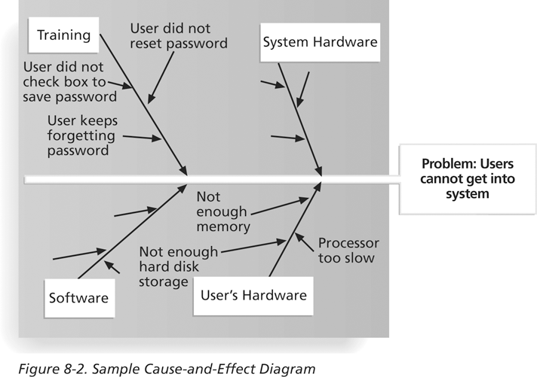
Sample Cause-and-Effect Diagram

Slide 15
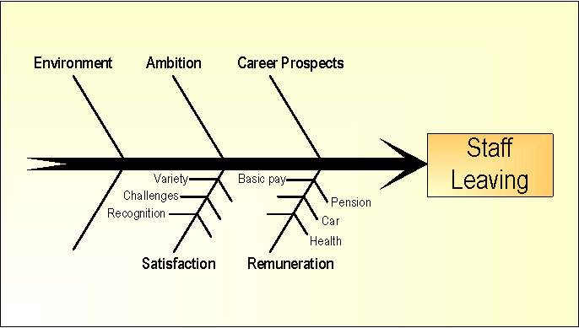
Sample Cause-and-Effect Diagram
Possible causes of staff leaving before the end of a project
They may include environment, ambition, career prospects, satisfaction (variety, challenges, recognition), remuneration (basic pay, benefits - car, health, pension).

Slide 16
Quality Control Charts
A control chart is a graphic display of data that illustrates the results of a process over time
The main use of control charts is to prevent defects, rather than to detect or reject them
Quality control charts allow you to determine whether a process is in control or out of control
When a process is in control, any variations in the results of the process are created by random events; processes that are in control do not need to be adjusted
When a process is out of control, variations in the results of the process are caused by nonrandom events; you need to identify the causes of those nonrandom events and adjust the process to correct or eliminate them

Slide 17
The Seven Run Rule
You can use quality control charts and the seven run rule to look for patterns in data
The seven run rule states that if seven data points in a row are all below the mean, above the mean, or are all increasing or decreasing, then the process needs to be examined for nonrandom problems
Example: The following slide is a control chart for the manufacture of 12” rulers
Upper and lower specifications are 12.10” and 11.9” – this is the range specified as acceptable by the customer for purchase
The controls limits of 11.91” and 12.09” mean that the manufacturing process is designed to produce rulers within that range

Slide 18
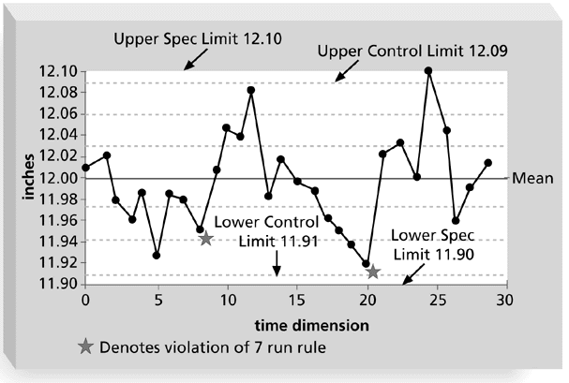
Sample Quality Control Chart
The rule violations indicate that a calibration device may need adjustment

Slide 19
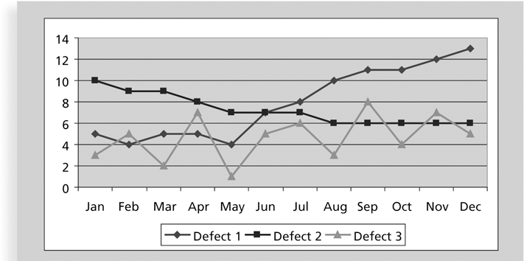
Run Chart
A run chart displays the history and pattern of variation of a process over time
It is a line chart that shows data points plotted in the order in which they occur
Can be used to perform trend analysis to forecast future outcomes based on historical patterns e.g., of defects

Slide 20
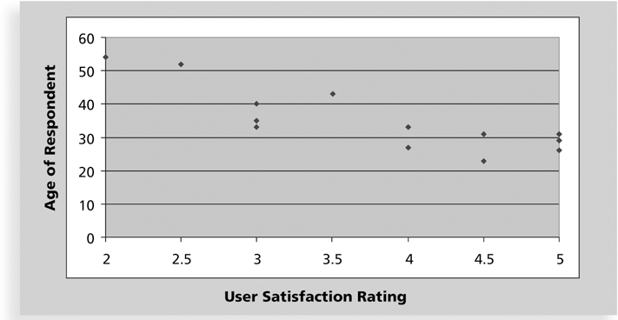
Scatter Diagram
A scatter diagram helps to show if there is a relationship between two variables
The closer data points are to a diagonal line, the more closely the two variables are related

Slide 21
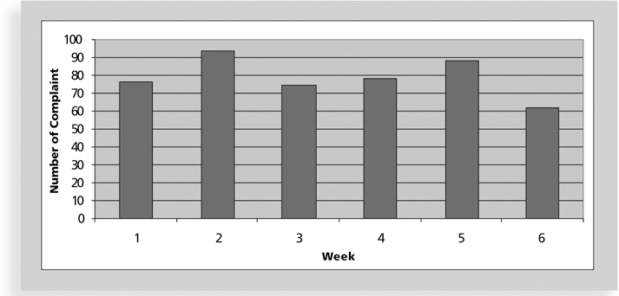
Histograms
A histogram is a bar graph of a distribution of variables
Each bar represents an attribute or characteristic of a problem or situation, and the height of the bar represents its frequency

Slide 22
Pareto Charts
A Pareto chart is a histogram that can help you identify and prioritize problem areas
The variables are ordered by frequency of occurrence to help identify the key contributors that account for most quality problems (hopefully following the 80-20 rule)
Pareto analysis is also called the 80-20 rule, meaning that 80 percent of problems are often due to 20 percent of the causes
In the following chart, Log-in Problems account for about 55% of the complaints and together with System lock-ups accounts for about 80%
Fixing these two problems can greatly reduce the volume of compalints
Small problems should be investigated before addressing them in case the user is in error

Slide 23
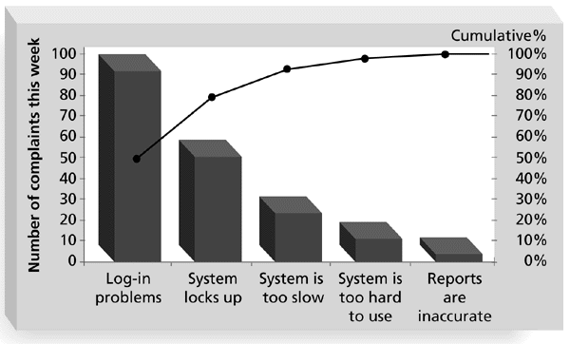
Sample Pareto Diagram

Slide 24
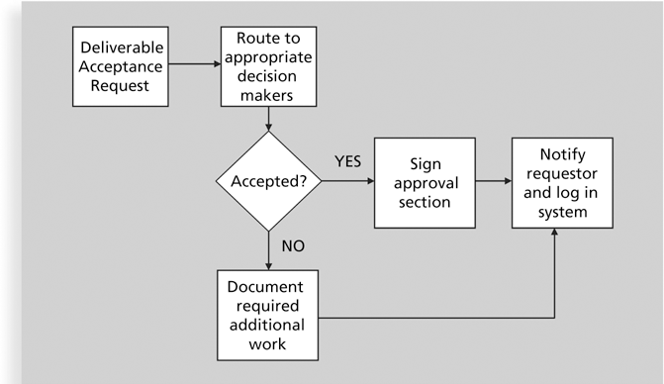
Flowcharts
Flowcharts are graphic displays of the logic and flow of processes that help you analyze how problems occur and how processes can be improved
They show activities, decision points, and the order of how information is processed

Slide 25
Statistical Sampling
Statistical sampling involves choosing part of a population of interest for inspection
This is needed when the population is too large be to be completely sampled
The size of a sample depends on how representative you want the sample to be
Sample size formula:
Sample size = .25 X (certainty factor/acceptable error)²
Desired certainty | Certainty factor | Sample size
95% | 1.960 | 384
90% | 1.645 | 68
80% | 1.281 | 10

Slide 26
Six Sigma
Six Sigma is “a comprehensive and flexible system for achieving, sustaining, and maximizing business success. Six Sigma is uniquely driven by close understanding of customer needs, disciplined use of facts, data, and statistical analysis, and diligent attention to managing, improving, and reinventing business processes.”*
*Pande, Peter S., Robert P. Neuman, and Roland R. Cavanagh, The
Six Sigma Way, New York: McGraw-Hill, 2000, p. xi.

Slide 27
Basic Information on Six Sigma
The target for perfection is the achievement of no more than 3.4 defects per million opportunities
The principles can apply to a wide variety of processes – design and production of a product, a Help Desk or other customer-service process
Six Sigma projects normally follow a five-phase improvement process called DMAIC

Slide 28
DMAIC
DMAIC is a systematic, closed-loop process for continued improvement that is scientific and fact based
Define: Define the problem/opportunity, process, and customer requirements. Tool used include project charter, requirements, Voice of the Customer data.
Measure: Define measures (in terms of defects per million), then collect, compile, and display data
Analyze: Scrutinize process details to find improvement opportunities; seeks root cause of problems
Improve: Generate solutions and ideas for improving the problem; pilot test the solution
Control: Track and verify the stability of the improvements and the predictability of the solution

Slide 29
How Is Six Sigma Quality Control Unique?
It requires an organization-wide commitment at all levels. Often huge training investements but pay off in higher quality goods and services at lower costs
Training follows the “Belt” system as in a karate class
Six Sigma organizations have the ability and willingness to adopt contrary objectives: reducing errors and getting things done faster; creative and rational; focus on the big picture and minute details; make customers happy and make a lot of money
It is an operating philosophy that is customer-focused and strives to drive out waste, raise levels of quality, and improve financial performance at breakthrough levels

Slide 30
What Went Right?
Motorola, Inc. pioneered the adoption of Six Sigma in the 1980s and saved about $14 billion in cumulative savings. Needed to survive Japanese competition
Allied Signal/Honeywell saved more than $600 million a year by reducing the costs of reworking defects and improving aircraft engine design processes. Talking about the process and the customer became part of their everyday conversation.
General Electric uses Six Sigma to focus on achieving customer satisfaction. Jack Welch urged his top managers to become “passionate lunatics” about Six Sigma

Slide 31
Six Sigma and Project Management
Joseph M. Juran stated, “All improvement takes place project by project, and in no other way”*
It’s important to select projects carefully and apply higher quality where it makes sense; companies that use Six Sigma do not always boost their stock values
Minimizing defects does not matter if an organization is making a product that no one wants to buy. As Mikel Harry puts it, “I could genetically engineer a Six Sigma goat, but if a rodeo is the marketplace, people are still going to buy a Four Sigma horse.”**
Six Sigma projects must focus on a quality problem or gap between the current and desired performance, not have a clearly understood problem, the solution should not be predetermined and an optimal solution should not be apparent
*“What You Need to Know About Six Sigma,” Productivity Digest (December 2001), p. 38.
**Clifford, Lee, “Why You Can Safely Ignore Six Sigma,” Fortune (January 22, 2001), p. 140.

Slide 32
Six Sigma Projects Use Project Management
The training for Six Sigma includes many project management concepts, tools, and techniques
For example, Six Sigma projects often use business cases, project charters, schedules, budgets, and so on
Six Sigma projects are done in teams; the project manager is often called the team leader, and the sponsor is called the champion
Six Sigma projects are projects that focus on supporting the Six Sigma philosophy by being customer-focused and striving to drive out waste, raise levels of quality and improve financial performance at breakthrough levels

Slide 33
Six Sigma and Statistics
The term sigma means standard deviation
Standard deviation measures how much variation exists in a distribution of data
Standard deviation is a key factor in determining the acceptable number of defective units found in a population.
A small s.d. means the data clusters closely around the middle of a distribution and there is little variability in the data.
Six Sigma projects strive for no more than 3.4 defects per million opportunities, yet this number is confusing to many statisticians

Slide 34
Six Sigma Uses a Conversion Table
Using a normal curve, if a process is at six sigma, there would be no more than two defective units per billion produced
Six Sigma uses a scoring system that accounts for time, an important factor in determining process variations
Yield represents the number of units handled correctly through the process steps
A defect is any instance where the product or service fails to meet customer requirements
Because most products or services have multiple customer requirements, there can be several opportunities to have a defect
Ex: a company is trying to reduce errors on their bills. There could be several errors – misspelled name, wrong address, calculation error, etc. Instead of measuring the number of defects per billing statement, Six Sigma measures the number of defects based on the number of opportunities

Slide 35
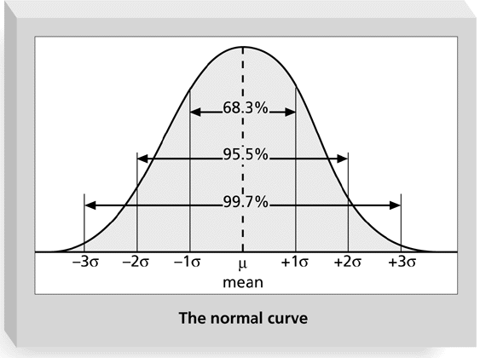
Normal Distribution and Standard Deviation

Slide 36
Normal Distribution and Standard Deviation
Specification Range (in +/- Sigmas) | % of population within range | Defective units per billion
1 | 68.27 | 317,300,000
2 | 95.45 | 45,400,000
3 | 99.73 | 2,700,000
4 | 99.9937 | 63,000
5 | 99.999943 | 57
6 | 99.9999998 | 2
36

Slide 37
Sigma Conversion Table
Sigma | Yield | Defects per Million Opportunities
1 | 31.0% | 690,000
2 | 69.2% | 308,000
3 | 93.3% | 66,800
4 | 99.4% | 6,210
5 | 99.97% | 230
6 | 99.99966% | 3.4

Slide 38
Six 9s of Quality
Six 9s of quality is a measure of quality control equal to 1 fault in 1 million opportunities
In the telecommunications industry, it means 99.9999 percent service availability or 30 seconds of down time a year
This level of quality has also been stated as the target goal for the number of errors in a communications circuit, system failures, or errors in lines of code
To achieve six 9s of quality requires continual testing to find and eliminate errors or enough redundancy and back-up equipment to reduce the overall system failure to that low a level

Slide 39
Testing
Many IT professionals think of testing as a stage that comes near the end of IT product development
Testing should be done during almost every phase of the IT product development life cycle

Slide 40
Types of Tests
Unit testing tests each individual component (often a program) to ensure it is as defect-free as possible
Integration testing occurs between unit and system testing to test functionally grouped components
System testing tests the entire system as one entity
User acceptance testing is an independent test performed by end users prior to accepting the delivered system

Slide 41
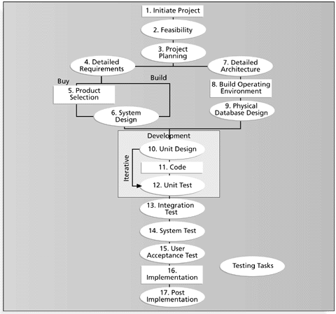
Testing Tasks in the Software Development Life Cycle
One way of portraying the systems life cycle
Shows 17 main tasks involved in a s/w development project and shows their realtionship to each other

Slide 42
Testing Alone Is Not Enough
Watts S. Humphrey, a renowned expert on software quality, defines a software defect as anything that must be changed before delivery of the program
Testing does not sufficiently prevent software defects because:
As code gets more complex, the number of defects missed by testing increases and becomes the problem of not just the testers but also of the paying customers
He estimates that finished code, after all testing, contains 5-6 defects per thousand lines of code
The number of ways to test a complex system is huge
Users will continue to invent new ways to use a system that its developers never considered
Humphrey suggests that people rethink the software development process to provide no potential defects when you enter system testing; developers must be responsible for providing error-free code at each stage of testing

Slide 43
Modern Quality Management
Modern quality management:
Requires customer satisfaction
Prefers prevention to inspection
Recognizes management responsibility for quality
Noteworthy quality experts include Deming, Juran, Crosby, Ishikawa, Taguchi, and Feigenbaum

Slide 44
Quality Experts
Deming was famous for his work in rebuilding Japan after WWII and his 14 Points for Management
His ideas were not accepted by US industry until Japan started producing products that seriously challenged American products, particularly in the auto industry
Juran wrote the Quality Control Handbook and ten steps to quality improvement
Stressed the difference between manufacturer’s view of quality focus on conformance to quality) and the customer’s view (fitness for use).
Crosby wrote Quality is Free and suggested that organizations strive for zero defects
He suggested that the cost of poor quality is so understated that companies can profitably spend unlimited amounts of money on improving quality

Slide 45
Quality Experts
Ishikawa developed the concepts of quality circles and fishbone diagrams
Quality circles are groups of non-supervisors and work leaders in a single company department who volunteer to conduct group studies on how to improve the effectiveness of work in their department
In Japan quality is a company wide commitment while in the US it is delegated to a few staff members
Taguchi developed methods for optimizing the process of engineering experimentation
Quality should be designed into the product and not inspected into it
Quality is best achieved by minimizing deviation from the target value
Robust design methods – focus on eliminating defects by substituting scientific inquiry for trial-and-error methods
Feigenbaum developed the concept of total quality control
Responsibility for quality should rest with the people who do the work
Product quality is more important that production rates and workers are allowed to stop production whenever a quality problem occurs

Slide 46
Malcolm Baldrige Award
The Malcolm Baldrige National Quality Award originated in 1987 to recognize companies that have achieved a level of world-class competition through quality management
Given by the President of the United States to U.S. businesses
Three awards each year in different categories
Manufacturing
Service
Small business
Education and health care

Slide 47
Malcolm Baldrige Award
Named after Malcolm Baldrige, the 26th Secretary of Commerce, the Baldrige Award was established by Congress in 1987 to enhance the competitiveness and performance of U.S. businesses.
Originally, three types of organizations were eligible: manufacturers, service companies and small businesses.
This was expanded in 1999 to include education and health care organizations, and again in 2007 to include nonprofit organizations (including charities, trade and professional associations, and government agencies).
The award promotes excellence in organizational performance, recognizes the achievements and results of U.S. organizations, and publicizes successful performance strategies.
The award is not given for specific products or services.

Slide 48
ISO Standards
ISO 9000 is a quality system standard that:
Is a three-part, continuous cycle of planning, controlling, and documenting quality in an organization
Provides minimum requirements needed for an organization to meet its quality certification standards
Helps organizations around the world reduce costs and improve customer satisfaction
See www.iso.org for more information and http://www.iso.org/iso/pressrelease.htm?refid=Ref1174 for a video clip

Slide 49
Improving Information Technology Project Quality
Several suggestions for improving quality for IT projects include:
Establish leadership that promotes quality
Understand the cost of quality
Focus on organizational influences and workplace factors that affect quality
Improving the organization’s overall maturity level in software development and project management

Slide 50
Leadership
As Joseph M. Juran said in 1945, “It is most important that top management be quality-minded. In the absence of sincere manifestation of interest at the top, little will happen below.”*
A large percentage of quality problems are associated with management, not technical issues
As globalization increases and customers become more demanding, creating quality products quickly at a reasonable price is essential for staying in business
In 1988, Motorola Corp. became one of the first companies to receive the Malcolm Baldrige National Quality Award.
One of Motorola's innovations that attracted a great deal of attention was its Six Sigma program.
Top management stressed the need to develop and use quality standards and provided resources (training, staff, customer input) to help improve quality
*American Society for Quality (ASQ), (www.asqc.org/about/history/juran.html).

Slide 51
The Cost of Quality
The cost of quality is the cost of conformance plus the cost of nonconformance
Conformance means delivering products that meet requirements and fitness for use
Cost of nonconformance means taking responsibility for failures or not meeting quality expectations
A 2018 study reported that software bugs cost the U.S. economy $59.6 billion (6% of GDP) each year and that one-third of the bugs could be eliminated by an improved testing infrastructure
Gartner Research estimated that the cost of downtime for computer networks is about $42,000/hour.
A worse than average system with a downtime of 30 minutes per day can cost more than $7 million per year.

Slide 52
Five Cost Categories Related to Quality
Prevention cost: cost of planning and executing a project so it is error-free or within an acceptable error range
Appraisal cost: cost of evaluating processes and their outputs to ensure that a project is either error-free or within an acceptable error range
Internal failure cost: cost incurred to correct an identified defect before the customer receives the product (rework, inventory costs due to defects, premature failure of products)
External failure cost: cost that relates to all errors not detected and corrected before delivery to the customer (warranty costs, product liability suits, future business losses)
Measurement and test equipment costs: capital cost of equipment used to perform prevention and appraisal activities

Slide 53
Five Cost Categories Related to Quality
Demarco found that the average large company devoted more than 60% of its s/w development efforts to maintenance
Around 50% of development costs are typically spent on testing and debugging software
Top management is primarily responsible for the high cost of nonconformance in IT
Top managers often rush their organizations to develop new systems and do not give project teams enough time ot resources to do a project right the first time
Top management must create a culture that embraces quality

Slide 54
Media Snapshot
A 2004 study by Nucleus Research Inc. estimated that spam would cost large companies nearly $2,000 per employee in lost productivity in 2004 alone, despite investments in software to block spam
Spam currently accounts for more than 70 percent of total e-mail volume worldwide
In just one month (August 2003), at least 50 new Internet viruses surfaced, and losses related to computer viruses cost North American companies about $3.5 billion
Businesses have suffered at least $65 billion in lost productivity because of computer viruses since 1997

Slide 55
Organizational Influences, Workplace Factors, and Quality
Study showed that organizational issues had a much greater influence on programmer productivity than the technical environment or programming languages
Programmer productivity varied by a factor of one to ten across all participants across all organizations, but only by 21% within the same organization
Study found no correlation between productivity and programming language, years of experience, or salary
A dedicated workspace and a quiet work environment were key factors to improving programmer productivity
Major problems in with work performance and project failures are sociological, not technological, in nature
They suggest minimizing office politics and giving smart people physical space, intellectual responsibility and strategic direction and then just letting them work
Manager should not make people work, but make it possible for people to work by removing political roadblocks

Slide 56
Expectations and Cultural Differences in Quality
Project managers must understand and manage stakeholder expectations
Expectations also vary by:
Organization’s culture – even within the organization
Geographic regions

Slide 57
Maturity Models
Maturity models are frameworks for helping organizations improve their processes and systems
An evolutionary path of increasingly organized and systematically more mature processes
The Software Quality Function Deployment Model focuses on defining user requirements and planning software projects resulting in a set of measurable technical product specifications and their priorities
Clearer requirements can lead to fewer design changes, increased productivity and ultimately s/w products that are more likely to satisfy stakeholder requirements
The Software Engineering Institute’s Capability Maturity Model Integration is a process improvement approach that provides organizations with the essential elements of effective processes
Companies may not get to bid on government projects unless they have a CMMI Level 3

Slide 58
CMMI Staged Representation
Optimizing
Optimizing
5
Focus on process improvement
Quantitatively
Managed
4
Process measured and controlled
Defined
Defined
3
Process characterized for the organization and is proactive
Managed
2
Process characterized for projects and is often reactive
Improvement planning, execution and measurement is sequential through the CMMI levels
Performed
1
Process unpredictable, poorly controlled and
reactive

Slide 59
PMI’s Maturity Model
PMI released the Organizational Project Management Maturity Model (OPM3) in December 2003
Model is based on market research surveys sent to more than 30,000 project management professionals, and incorporates 180 best practices and more than 2,400 capabilities, outcomes, and key performance indicators
Addresses standards for excellence in project, program, and portfolio management best practices and explains the capabilities necessary to achieve those best practices

Slide 60
Best Practice
OPM3 provides the following example to illustrate a best practice, capability, outcome, and key performance indicator:
Best practice: establish internal project management communities
Capability: facilitate project management activities
Outcome: local initiatives, meaning the organization develops pockets of consensus around areas of special interest
Key performance indicator: community addresses local issues
Best practices are organized into three levels: project, program and portfolio. Within each category, best practices are categorized by four stages of process improvement: standardize, measure, control and improve

